Slide 1
Welcome to our assessment week results afternoon
Please take a seat, your child will join you shortly

Slide 2
Housekeeping
No fire drill expected
Fire exits/assembly point
Mobile phones/photography
Habits of attention

Slide 3
Thank you
Together we can make a difference
Amazing potential

Slide 4
The key dates
Monday 13 May 2024 | English grammar, punctuation and spelling papers 1 and 2
Tuesday 14 May 2024 | English reading – 60 minutes
Wednesday 15 May 2024 | Mathematics papers 1 - Arithmetic. - 30 minutes Mathematics paper 2. - Reasoning. - 40 minutes
Thursday 16 May 2024 | Mathematics paper 3 – Reasoning – 40 minutes

Slide 5
Attendance
Every day counts

Slide 6
September — February 1/2 term
Percentage Attendance | Hours of education lost | Weeks missed at school | School days missed
100% | 0 | 0 | 0
97% | 15 | 0 | 3
95% | 25 | 1wk 1dy | 5
90% | 50 | 2wks | 10
86% | 70 | 2wks 4dys | 14
80% | 100 | 4wks | 20
75% | 125 | 5wks | 25
70% | 145 | 5wks 4dys | 29
60% | 194.5 | 7wks 4.5dys | 39.5
50% | 247.5 | 9wks 4.5dys | 49.5

Slide 7
Aims
Explain
Explain how to understand your child’s results
Share
Share your child’s results
Provide
Provide time to look through your child’s SATs papers
Signpost
Signpost areas of support and next steps

Slide 8
100

Slide 9
110

Slide 10
Tests & Outcomes
Subject | How assessed | What do the outcomes mean?
Reading | 1x 60 min test paper | Less than 100 = Not met standard 100-109 = Expected standard 110+ = Greater depth standard
Writing | Teacher judgement against a specific KS2 framework | Pre-key stage (HNM on report card) Working towards KS2 standard (WTS on report card) Working at KS2 standard (EXS on report card) Working at Greater Depth (GDS on report card)
Maths | 3x tests: 1x 30 min arithmetic test paper 2x 40 min reasoning test paper | Less than 100 = Not met standard 100-109 = Expected standard 110+ = Greater depth standard
Spelling, punctuation and Grammar | 2x tests 1x 45 min punctuation and grammar test paper 1x spelling test (no time limit) | Less than 100 = Not met standard 100-109 = Expected standard 110+ = Greater depth standard

Slide 11
What’s in the results envelope?
Letter with key information and upcoming dates
01
Report card with outcomes, attendance and behaviour information
02
Question Level Analysis (QLA) to identify strengths and areas to improve.
03
Example of KS2 writing framework
04

Slide 12
Report cards

Slide 13
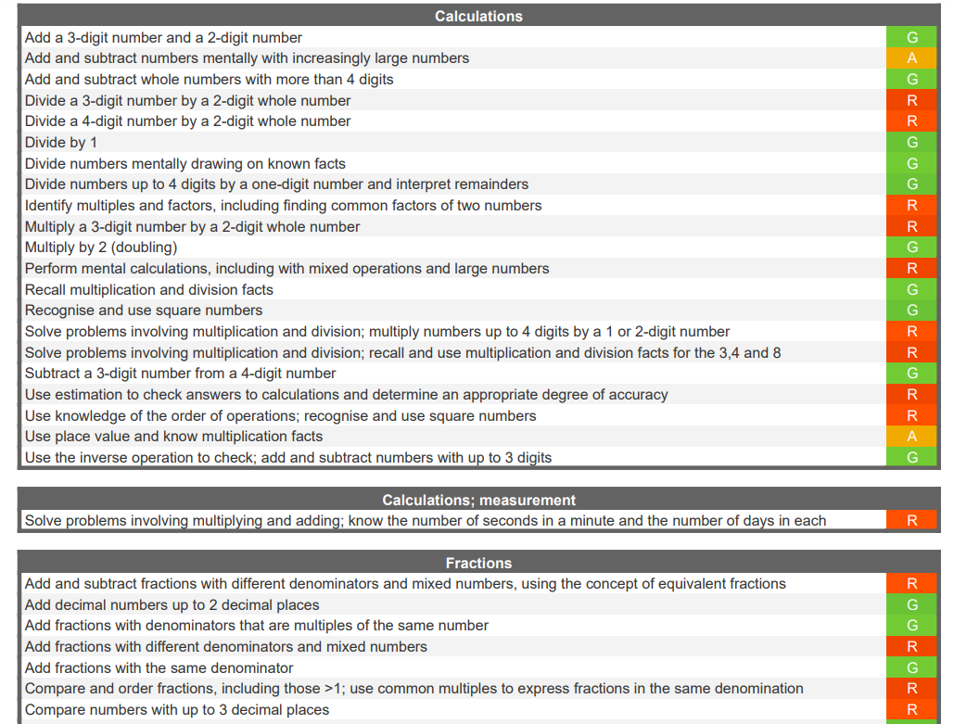
Question Level Analysis (QLA)

Slide 14
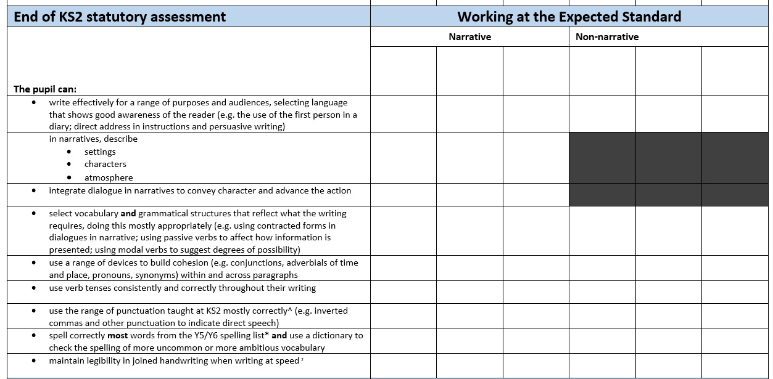
Writing framework

Slide 15
TESTED SUBJECTS (READING, MATHS, SPAG) | N-99 = NOT MET STANDARD 100-109 = EXPECTED STANDARD 110+ = GREATER DEPTH STANDARD
WRITING | PRE-KEY STAGE (Y2 standard): HNM/BLW/B WORKING TOWARDS KS2 = WTS EXECTED STANDARD = EXS GREATER DEPTH = GDS

Slide 16
Next Parent Event (28.2.24)
Wednesday 28th February 2024
Maths focus (with PET-XI)

Slide 17
Thank you!
Use links available on Year 6 page on school website
Speak to your child’s class teacher if there is anything further you would like support with

