Slide 1
YEAR 6 SATS
Supporting parents on the road to success

Slide 2
What are SATS?
Standardized Assessment Tests
All Primary Children in Year 6 must sit them

Slide 3
When?
Over 4 days
Monday 13th May 2023 to Thursday 16th May 2023
In school under formal conditions – no communication between students

Slide 4
What do we test?
Grammar, Punctuation and Spelling
Reading
Maths

Slide 5

Writing
Assessed by school staff based on Year 6 evidence

Slide 6
Marking
Externally
Results in July
Receive a score between 80 - 120

Slide 7
Expected standard
100

Slide 8
Greater depth
110

Slide 9
Specific arrangements for SATs:
Children with additional needs, who have similar provision in their day-to-day learning at school, may be allotted specific arrangements, including:
Additional (extra) time;
Tests being opened early to be modified;
An adult to read for them;
An adult to scribe (write) for them;
Written or spoken translations of the mathematics reasoning papers;
The use of prompts or rest breaks;
Arrangements for children who are ill or injured at the time of the tests.
*Pupils with an EHC plan are automatically allowed up to 25% additional time (except for the spelling paper, which is not strictly timed). Pupils who use the modified large print or braille versions of the tests are automatically allowed up to 100% additional time

Slide 10
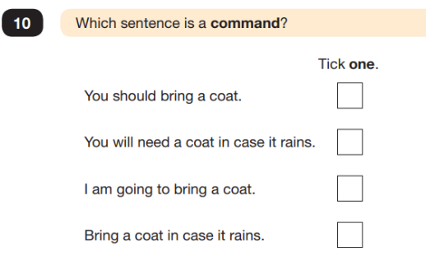
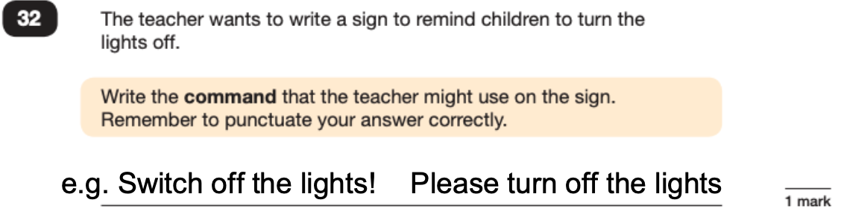
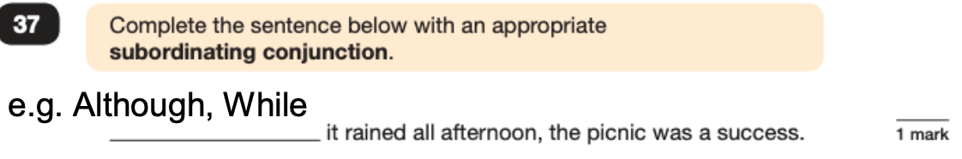
Grammar, Punctuation and Spelling (Paper 1)

Slide 11
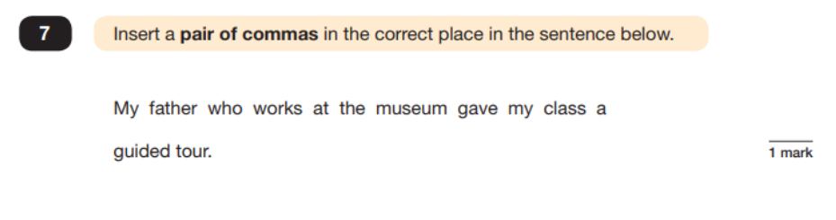

Slide 12
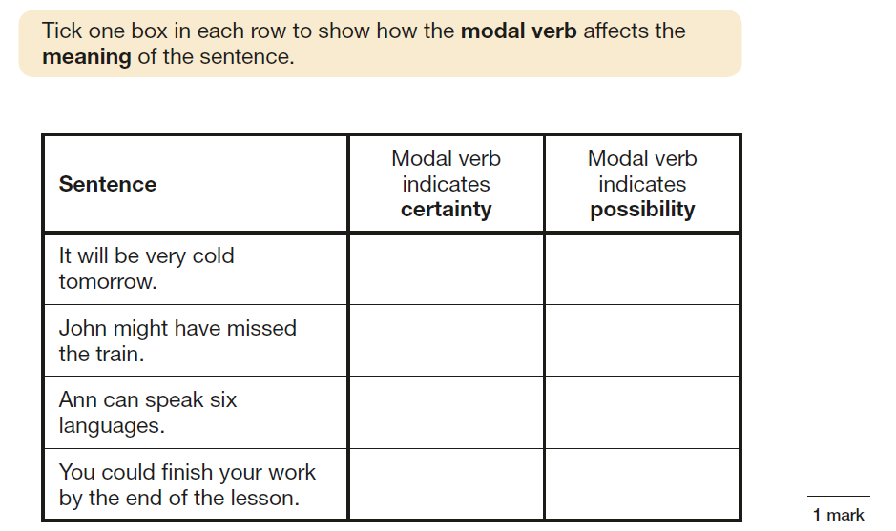
Further examples

Slide 13
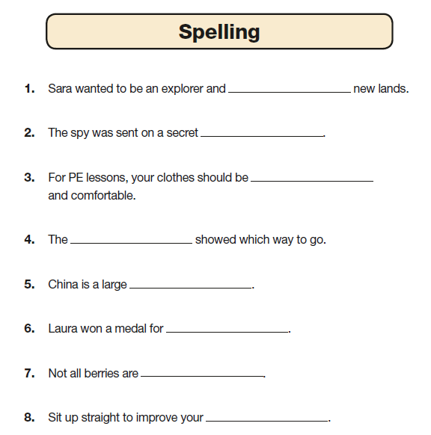
Spelling
20 words
Approximately 15 minutes
No set time

Slide 14
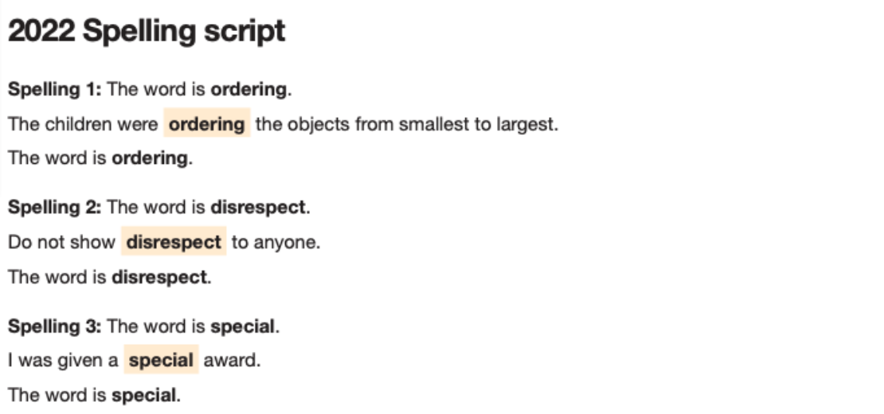
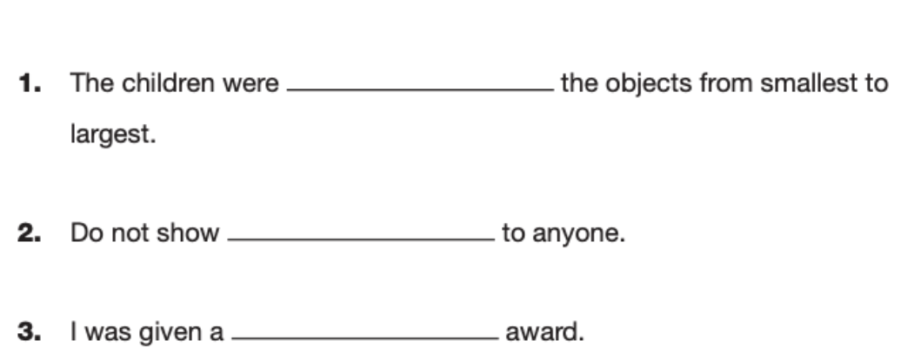
How the test is run

Slide 15
Reading
There is one reading test that lasts for 60 minutes.
The test is designed to measure if the children’s comprehension of age-appropriate reading material meets the national standard.
There are three different set texts for children to read. These could be any combination of non-fiction, fiction and/ or poetry.
To be successful children need to read accurately at speed
90 words per minute

Slide 16
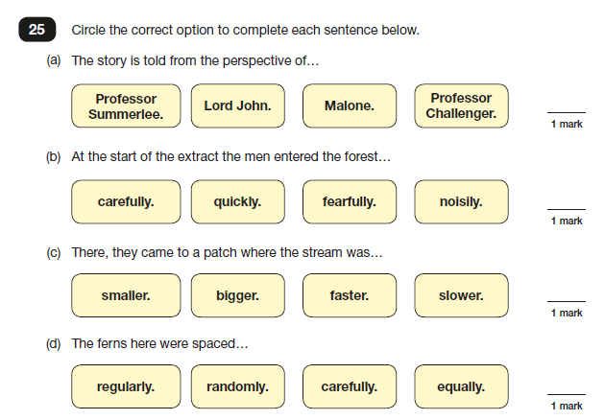

Slide 17
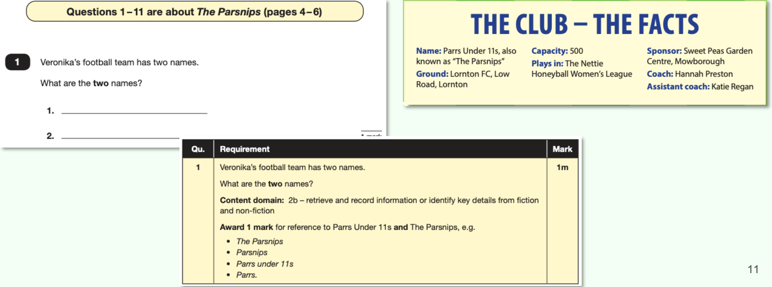
A range of answer styles

Slide 18
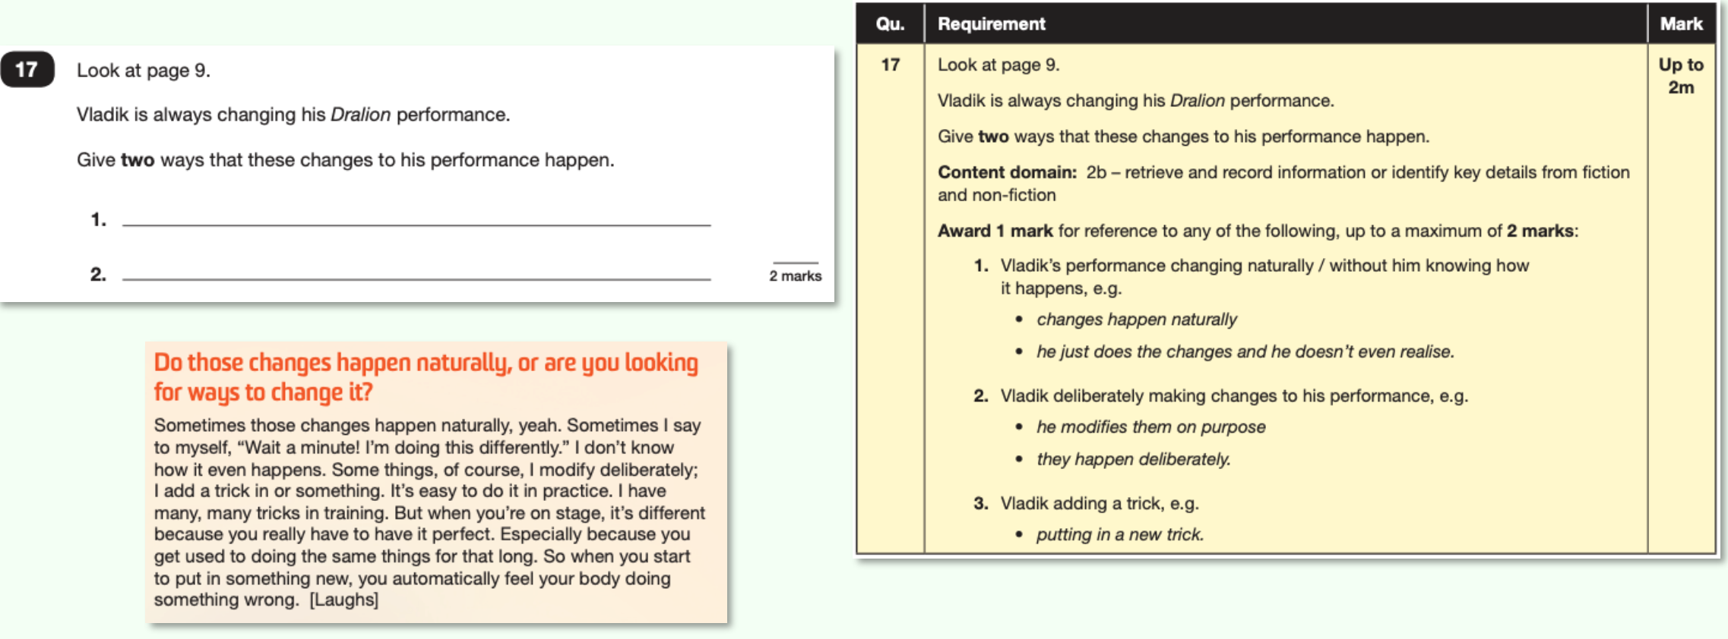

Slide 19
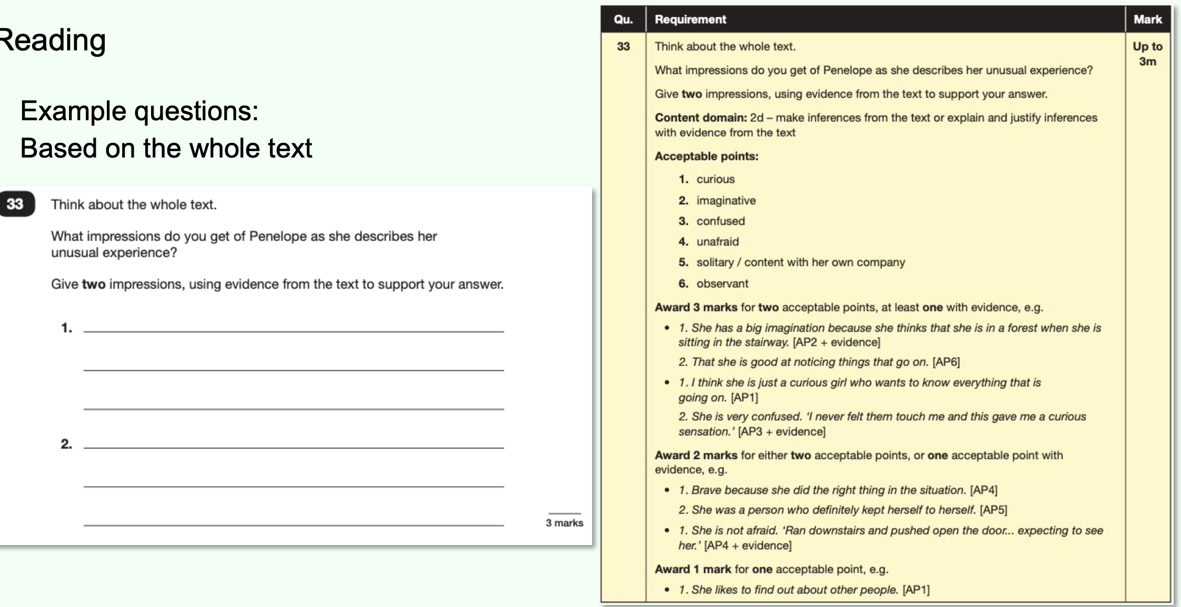

Slide 20
Top tips
In the 2022 Reading SATs paper
10% of marks could be gained from answering questions involving giving and explaining the meaning of words in context;
38% of marks could be gained from answering questions involving retrieving and recording information or identifying key details from a text;
44% of marks could be gained from answering questions involving making inferences from a text and justifying inferences with text evidence.
When reading with your child at home try focusing on these types of questions.

Slide 21
Maths
3 papers
15th May – Arithmetic (30 minutes)
15th May - Reasoning (40 minutes)
16th May – Reasoning (40 minutes)

Slide 22
Arithmetic – 30 minutes
40 marks
Addition
Subtraction
Multiplication
Division
Order of operations – BIDMAS
Percentages of amounts
Calculating with fractions

Slide 23
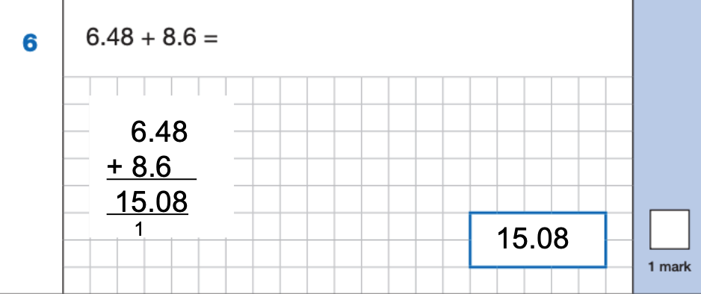
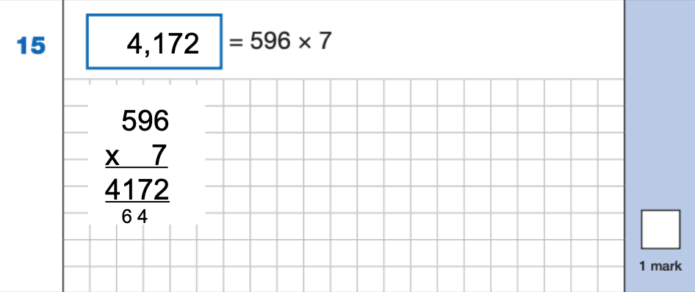
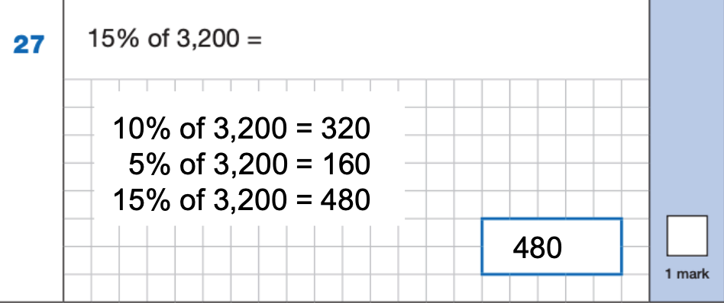
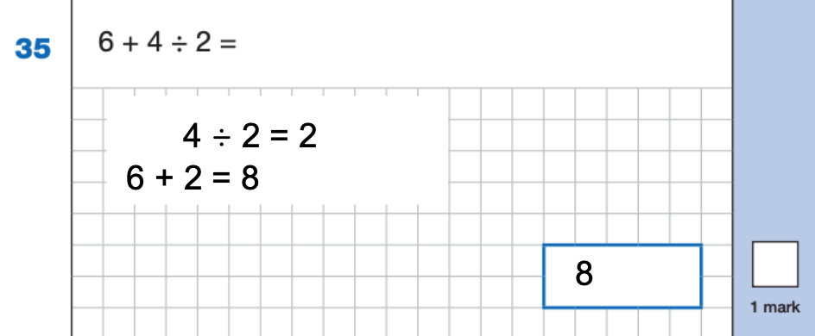
Example 1 mark questions

Slide 24
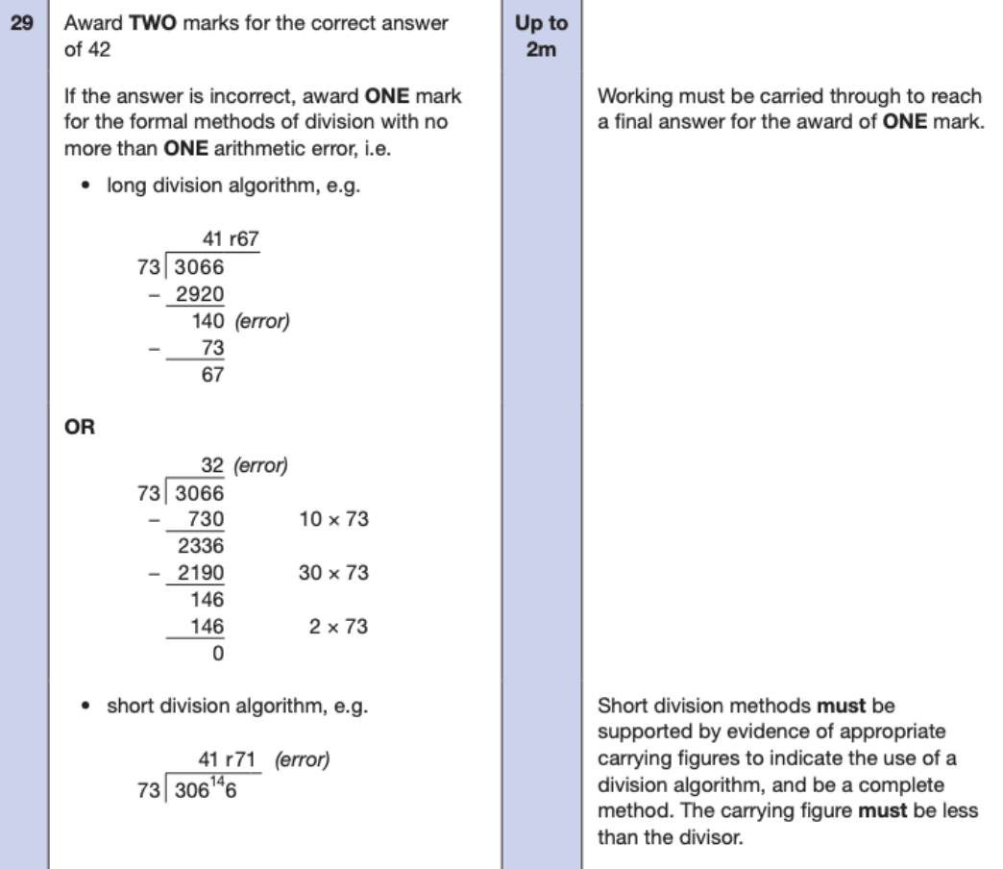
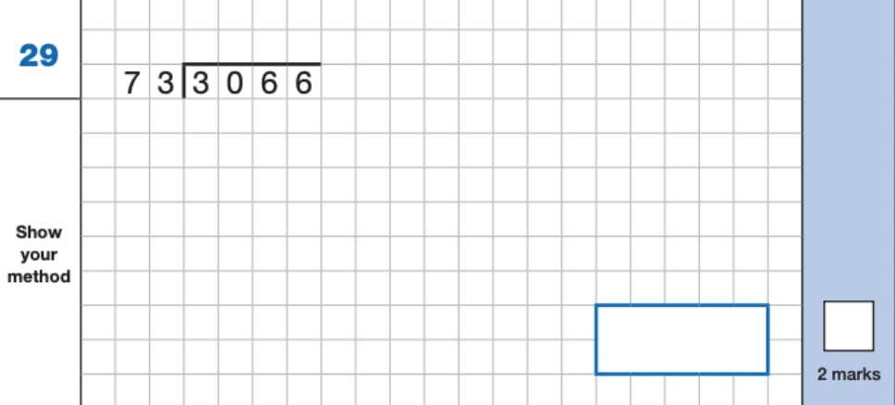
Example 2 mark questions

Slide 25
Papers 2 & 3 Reasoning – 40 minutes
35 marks each in 40 minutes
Show mathematical knowledge and skills and problem solving and reasoning
Key topics include:
Number and place value
4 operations
Geometry
Statistics
Measurement
Algebra
Ratio and Proportion
Fractions and decimals

Slide 26
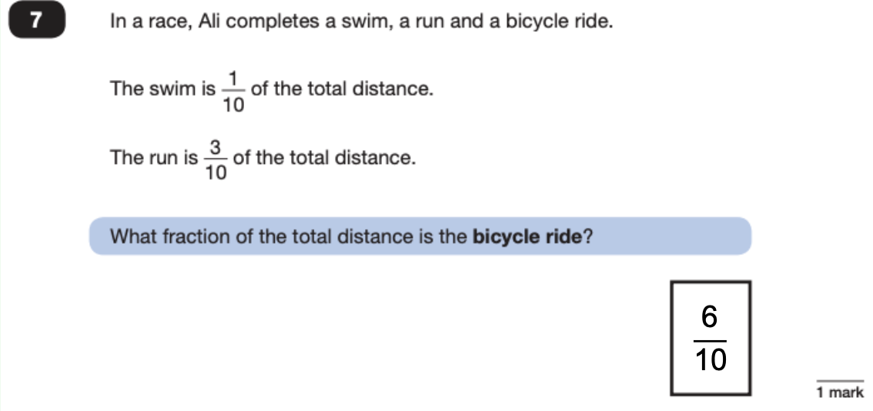
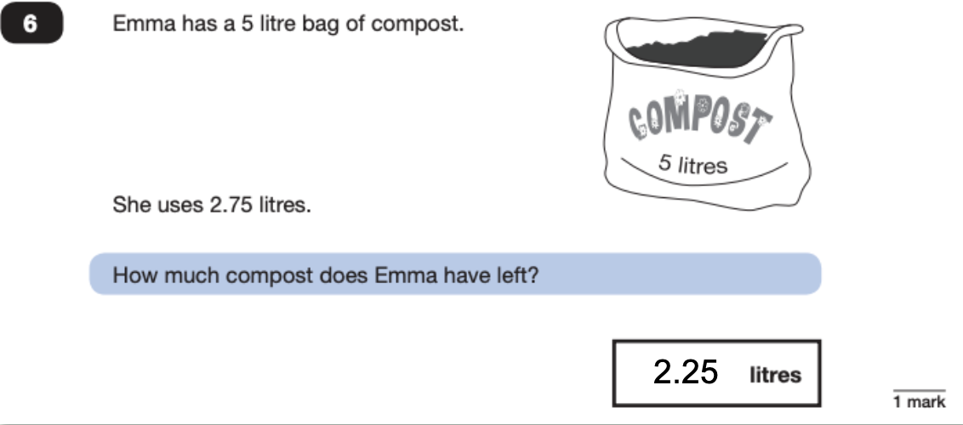
Paper 2 Reasoning

Slide 27
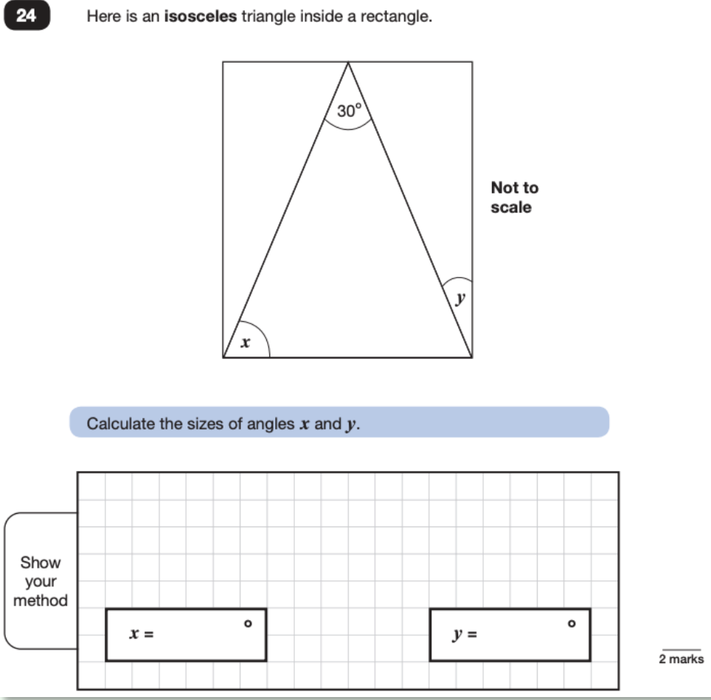
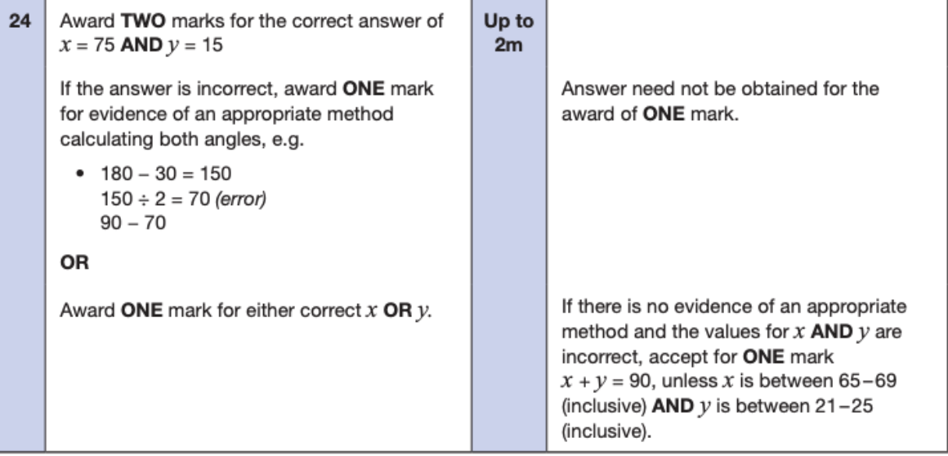
Paper 2 Reasoning

Slide 28
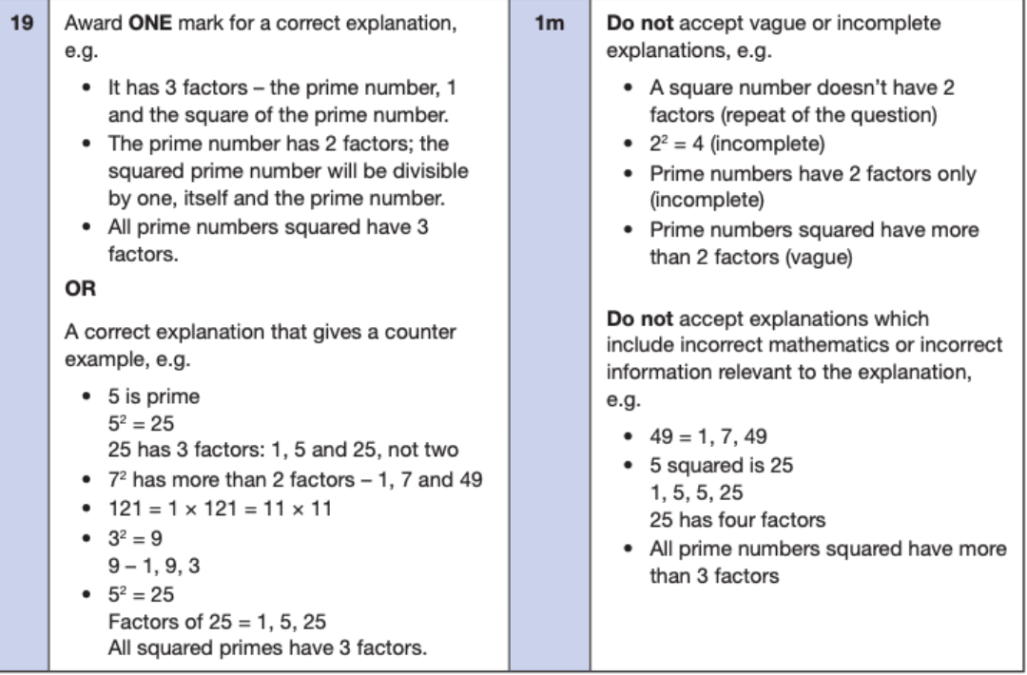
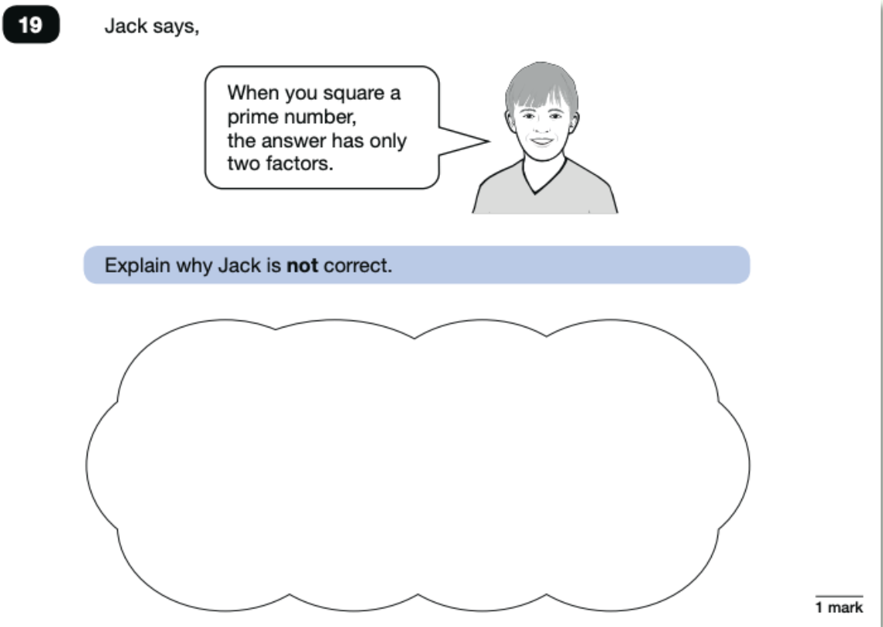
Paper 3 Reasoning

Slide 29
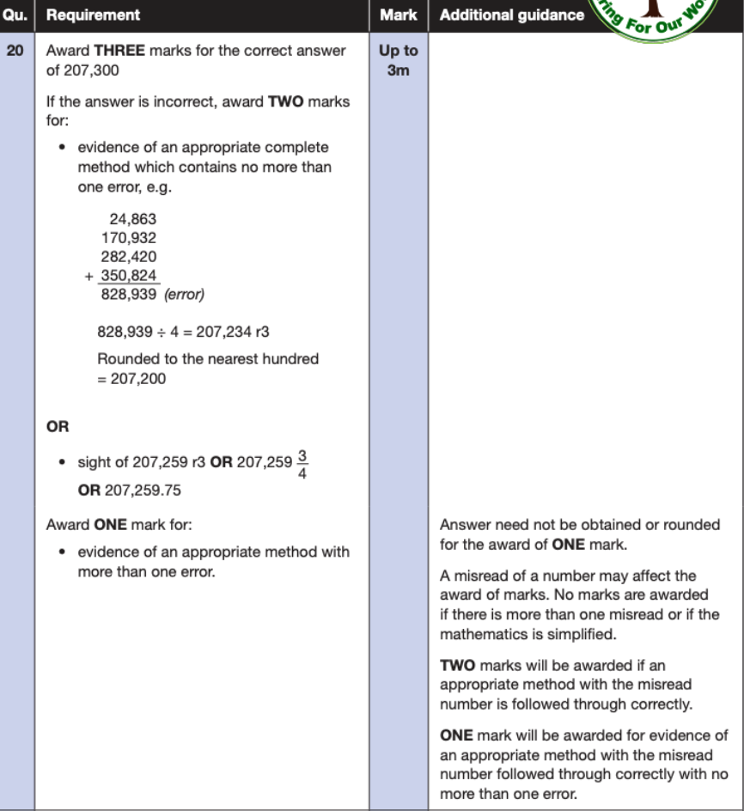
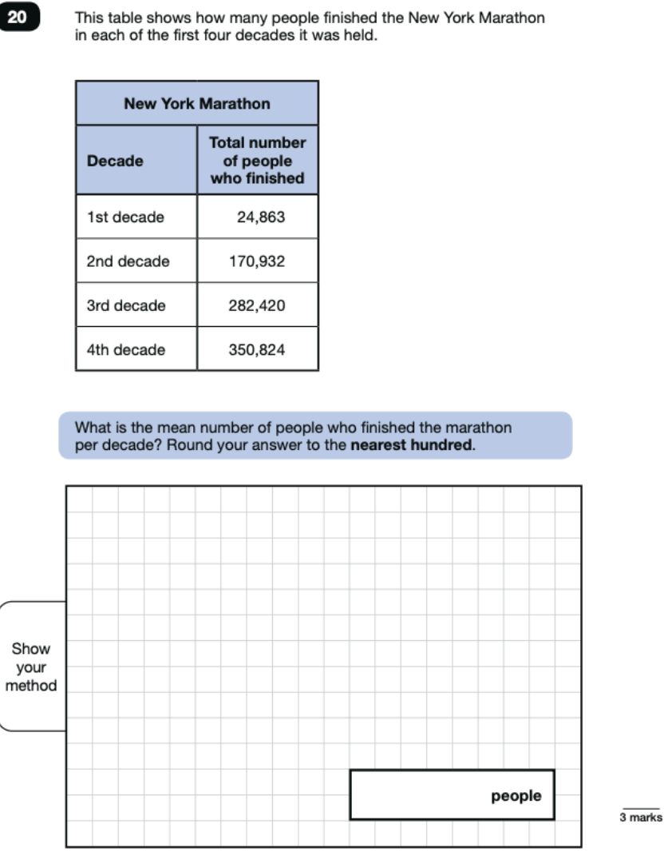
Paper 3 - Reasoning

Slide 30
At home
Regular routines for homework
Make it fun
Regular reading – make it for pleasure
Great online learning sites

Slide 31
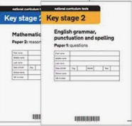



Slide 32
SATS Ready – the basics
Learn spellings
Do homework
Healthy breakfast
Early night
Drink water
Be positive and stay calm
Daily reading

Slide 33
SATS WEEK
Free breakfast from 8.15am
Normal school start and finish time
Tests in familiar places

Slide 34
The key dates
Monday 13 May 2024 | English grammar, punctuation and spelling papers 1 and 2
Tuesday 14 May 2024 | English reading – 60 minutes
Wednesday 15 May 2024 | Mathematics papers 1 - Arithmetic. - 30 minutes Mathematics paper 2. - Reasoning. - 40 minutes
Thursday 16 May 2024 | Mathematics paper 3 – Reasoning – 40 minutes

Slide 35
The SATS day
Breakfast from 8.15
8.45 – Registration
SATS paper
Extended break
Reduced session before lunch
Lunch
SATS revision

Slide 36
POST SATS
Residential visit
Sports Activities
Preparation for Secondary School
Focus on writing
End of year celebrations

Slide 37
Remember…..
SATS show your child’s ability in English and Maths, not their whole character
It’s 4 days
’All they can do is their best’

Slide 38

Coping with SATS
Keep talking
Notes:
Should not affect a childs eating, stress, increase anxiety
Talk to us
We cannot remove SATS but give strategies and support to learn how to cope

Slide 39

Questions?

