Slide 1
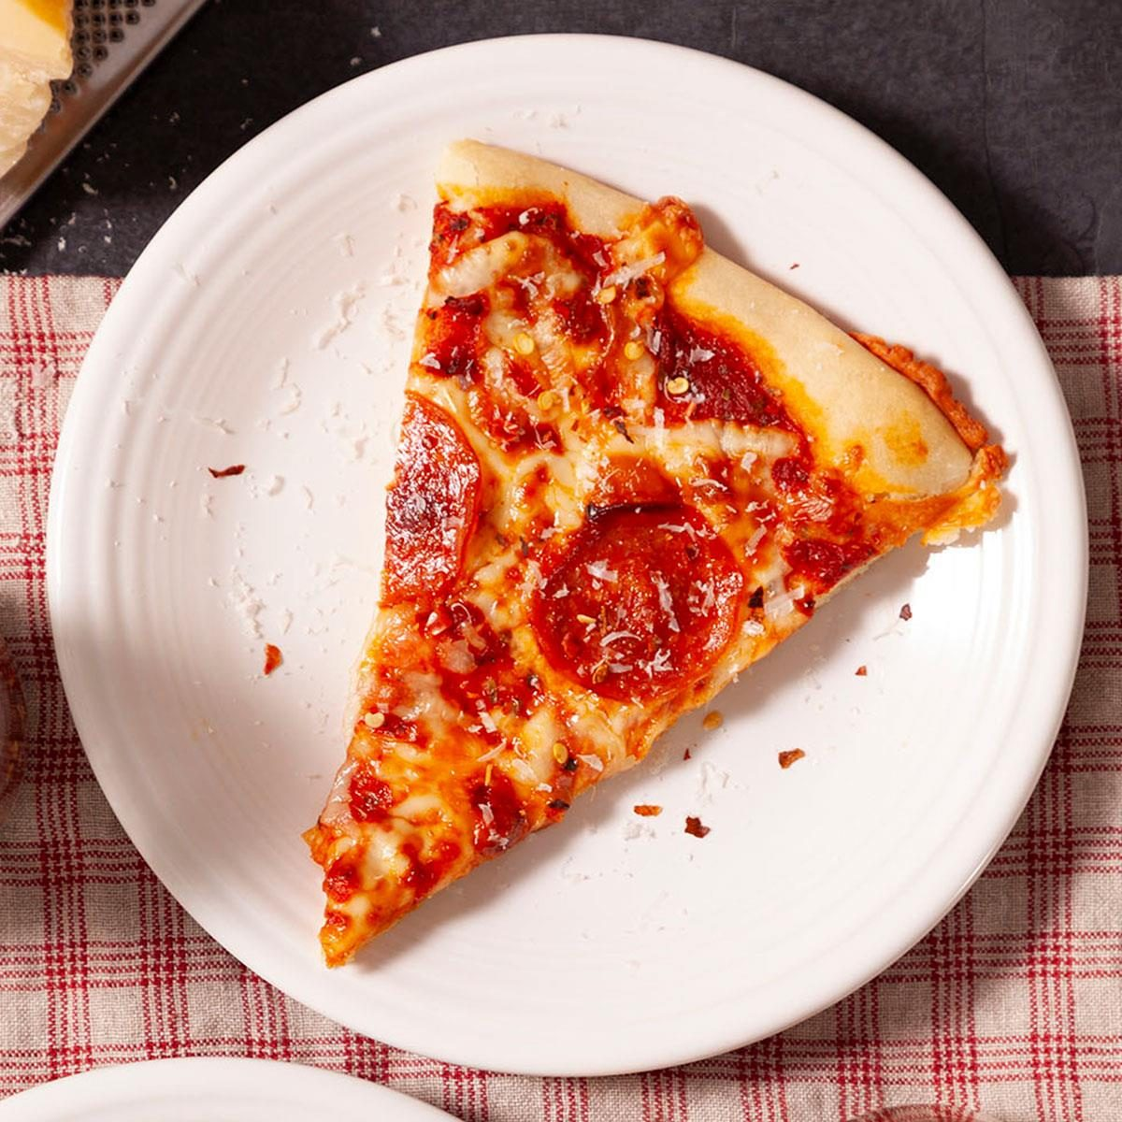
Welcome to our Reading and Pizza Night!!
What was your favourite book as a child?
Why was it your favourite book?

Slide 2
Housekeeping
No fire drill expected
Fire exits/assembly point
Mobile phones/photography
Habits of attention

Slide 3
Aims
Model teaching strategies for different question types
Opportunity to practise questions
Opportunity to practise SATs timings
Provide hints and tips for home support
Speak to class teachers

Slide 4
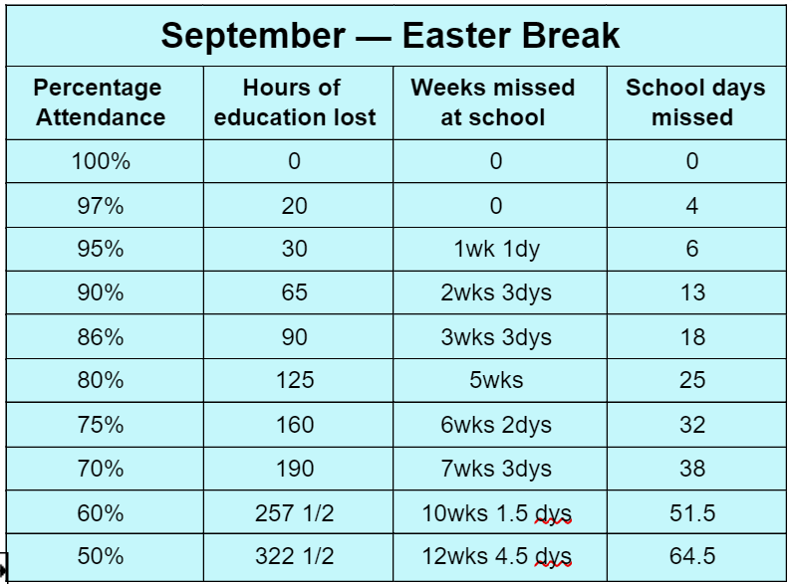
Attendance

Slide 5
70

Slide 6
100

Slide 7
Vocabulary
Trinkets
1. Scan the text, underline the word and read the word in context.
Paula rifled with interest through the dusty box of trinkets before picking out a few items for closer inspection.

Slide 8
Vocabulary
Trinkets
2. Identify the word class (noun, verb, adjective, adverb etc.)
Paula rifled with interest through the dusty box of trinkets before picking out a few items for closer inspection.

Slide 9
Vocabulary
Trinkets
3. Use context cues and prior knowledge
Paula rifled with interest through the dusty box of trinkets before picking out a few items for closer inspection.

Slide 10
Vocabulary
Trinkets
4. What could you replace the word with?
Paula rifled with interest through the dusty box of trinkets before picking out a few items for closer inspection.

Slide 11
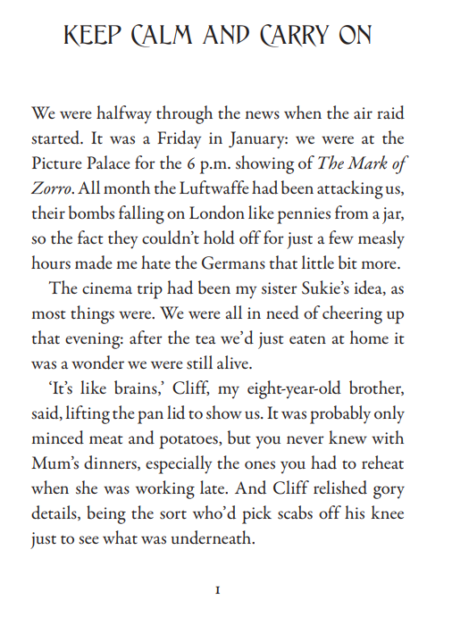
Your turn…Questions on WHITE PAPER
REMINDERS:
Scan the text, underline the word and read the word in context.
Identify the word class (noun, verb, adjective, adverb etc.)
Use context cues and prior knowledge
What could you replace the word with?

Slide 12
Retrieval (Who? What? Where? When? Why? How?)
Strategies:
Underline key word in question
Find the relevant part of text (speed/comprehension helps)
Re-read relevant part – underline direct word/phrase

Slide 13
Your turn
Match the answer with the question type.
who
Tina
what
so that they could hear the music more clearly
why
Mount Everest
how
by stirring it until there are no lumps
Show all
Click on an object to see any others with which it is linked. Once an object is clicked it will turn blue.

Slide 14
Your turn…Questions on BLUE PAPER
REMINDERS:
Underline key word in question
Find the relevant part of text (speed/comprehension helps)
Re-read relevant part – underline direct word/phrase

Slide 15
Inference (‘reading between the lines’)
Strategies:
How does the character act?
How do other characters react to the character/setting?
How is the character/setting described?
What do characters say? How do they say it?
How would you feel if you were in their position?

Slide 16
Example
Amelia, the courageous and curious one, was excited and eager to set out on the journey immediately. "This could be our biggest adventure yet!" she exclaimed, her eyes sparkling with anticipation.
Amelia's reaction was one of excitement and curiosity. She immediately saw the map as an opportunity for a great adventure.
What does this tell us about Amelia?

Slide 17
Model
Amelia, the courageous and curious one, was excited and eager to set out on the journey immediately. "This could be our biggest adventure yet!" she exclaimed, her eyes sparkling with anticipation.
Amelia's reaction was one of excitement and curiosity. She immediately saw the map as an opportunity for a great adventure.
What does this tell us about Amelia?
It suggests that she is a daring and adventurous character. Her excitement also suggests that she is a curious person who enjoys exploring the unknown.

Slide 18
Your turn…Questions on ORANGE PAPER
REMINDERS:
How does the character act?
How do other characters react to the character/setting?
How is the character/setting described?
What do characters say? How do they say it?
How would you feel if you were in their position?

Slide 19
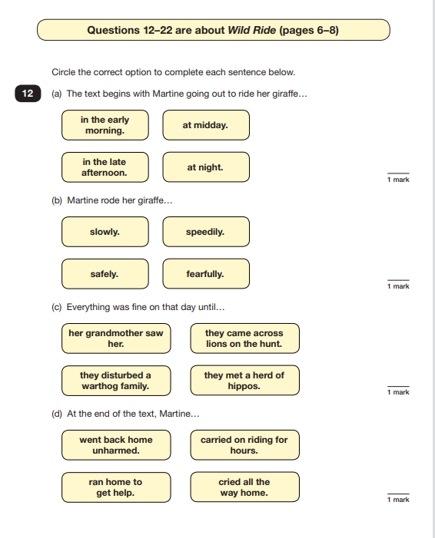
PIZZA & SATs Practise
Children BE THE EXPERT!
20 minutes

Slide 20
Spring 1 Challenge (5 weeks)
3 OPTIONAL CHALLENGES (completed before Monday 12th February 2024)
Read 25 times at home and have your reading record signed by an adult
Complete a writing unit on Oak Academy on ‘A Christmas Carol’.
Complete Pinpoint booklet for maths gaps

Slide 21
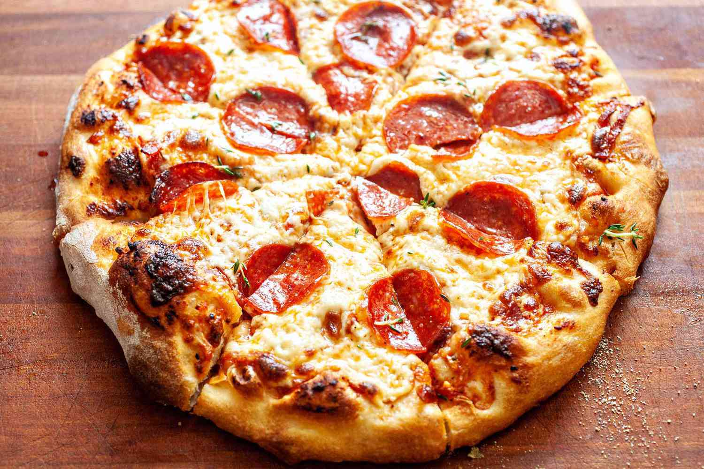
So…what’s the prize?
IF you complete ALL THREE challenges by Monday 12th February 2024
AFTERNOON MOVIE AND PIZZA PARTY!!!!!

Slide 22
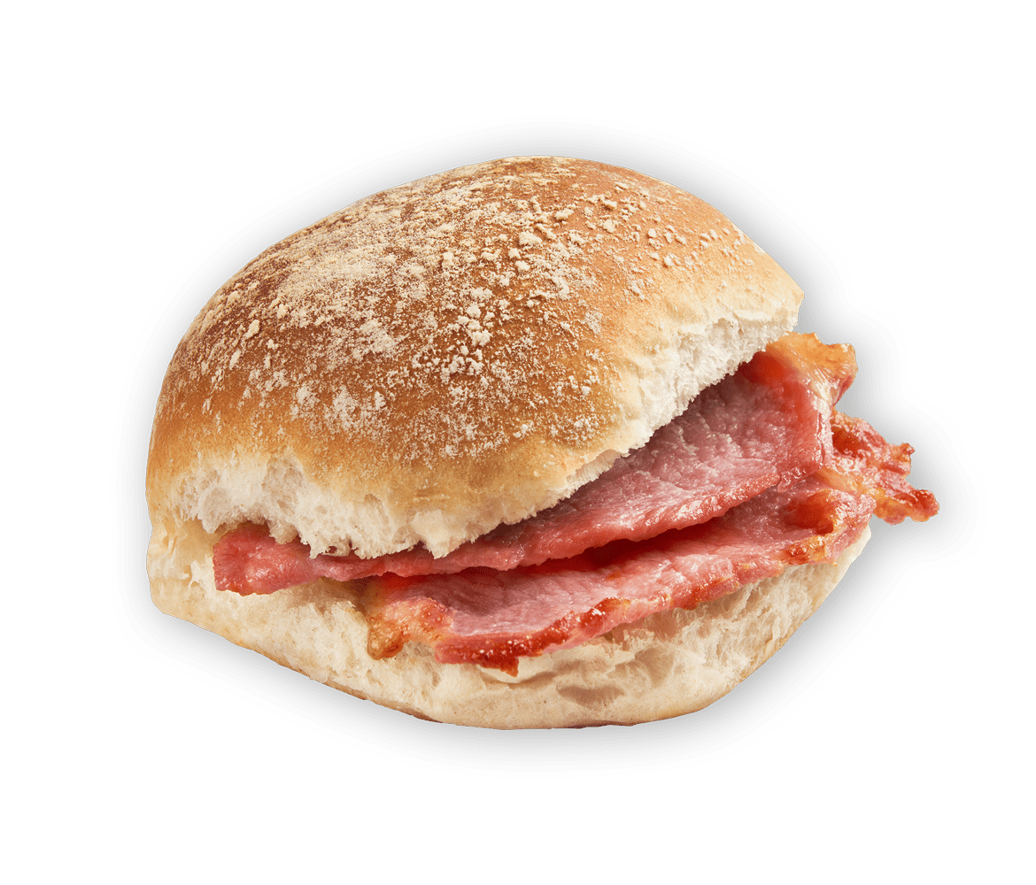
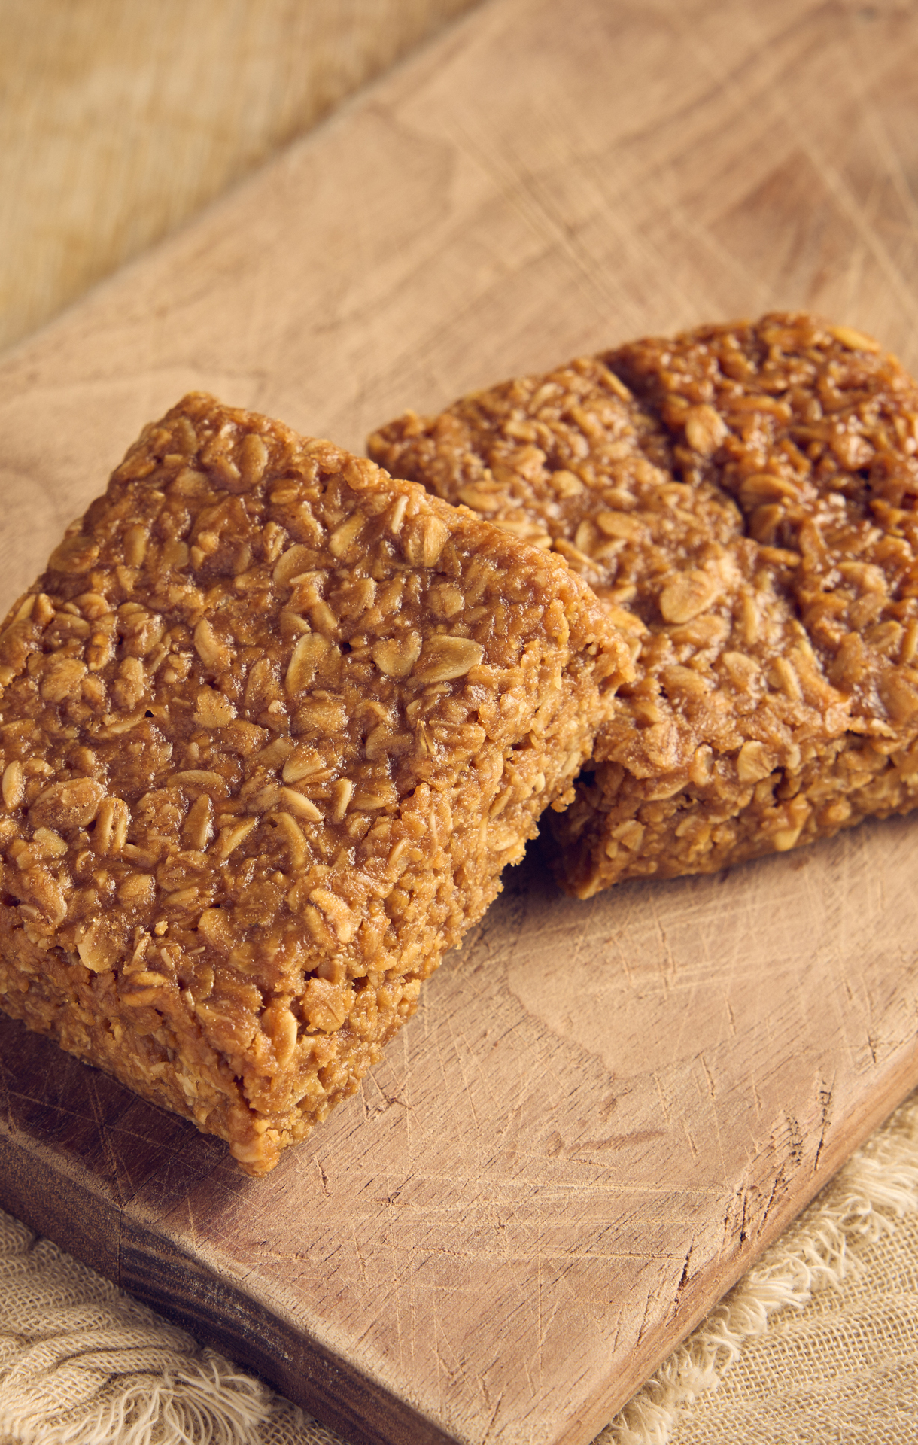
Next Assessment Week = 22nd January 2024
6 teaching days away!
What will be different?
Breakfast upon arrival (in canteen)
Different rooms (smaller groups)
What will be the same?
Same tests done on the same days
Expectation of best effort

Slide 23
Thank you!
Evaluation form will be sent by email
Take any resources with you for reference
Check the school website (Year 6 area coming soon…)

